Slide 1

Chapter 1.2
953321 SOFTWARE REQUIREMENT ANALYSIS: 1-2024
Inception
Asst. Prof Dr. Pattama Longani

Slide 2
Requirements Process
1. Inception
2. Elicitation
3. Elaboration
4. Negotiation
5. Specification
6. Validation
7. Requirement Management

Slide 3
Bless off Meeting
Who
issue!
why
Goal and Outcome
What
Where
When

Slide 4
INCEPTION
Identifies the work area the product will be used
Determines the purpose of the product
Identifies the stakeholders
Lays the list of the features in the product.

Slide 5
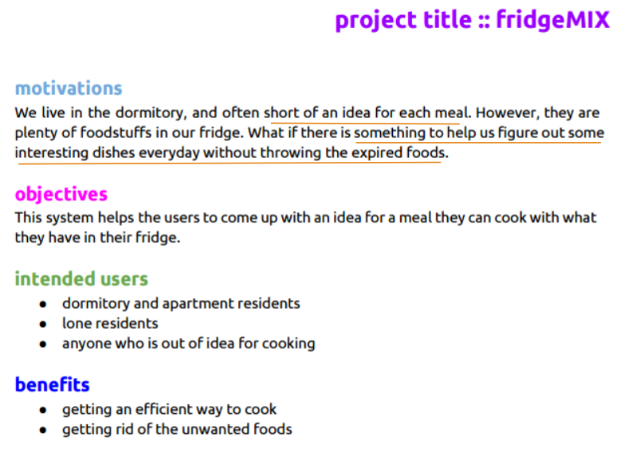
The deliverable of the initial meetings is a one- or two-page “product request” including stakeholders, overall goals, benefits, scope of the problem, and overall perception of a solution.
Notes:
the begining you may not be able to built the house because there are many information that you have to find
you just imagine that these people want your program, however in the real situation they may not want to use your program

Slide 6
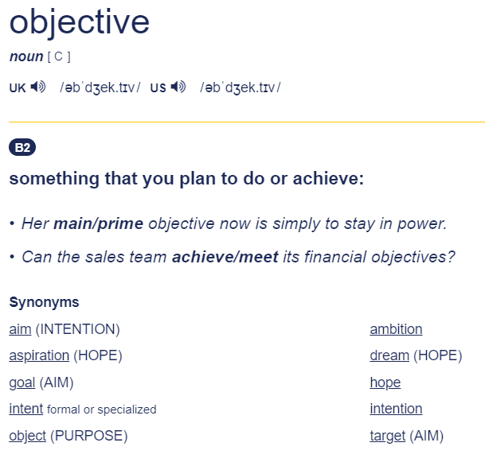
https://dictionary.cambridge.org/dictionary/english/objective
https://dictionary.cambridge.org/thesaurus/articles/something-you-want-to-do-or-achieve

Slide 7
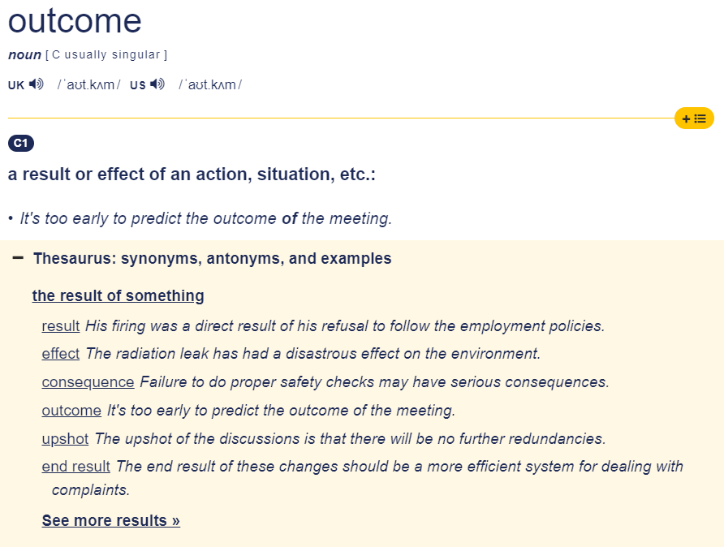
https://dictionary.cambridge.org/dictionary/english/outcome

Slide 8

What’s the requirements
to build your own house?
Notes:
Let see an example of builing a house a

Slide 9




What’s the requirements
to build your family house?

Slide 10
There are variety of things
on building The same thing,
a house!

Slide 11
To built a house to live with my family
User = father mother me
To built a house to support the elderly
User = any elderly who can walk

Slide 12
Should we build this house ?

Slide 13
Motivation
To solve problem
To support need

